Slide 1
Parallel Final Project
Nathaniel Wendt
Chris King
Dan Rahm

Slide 2
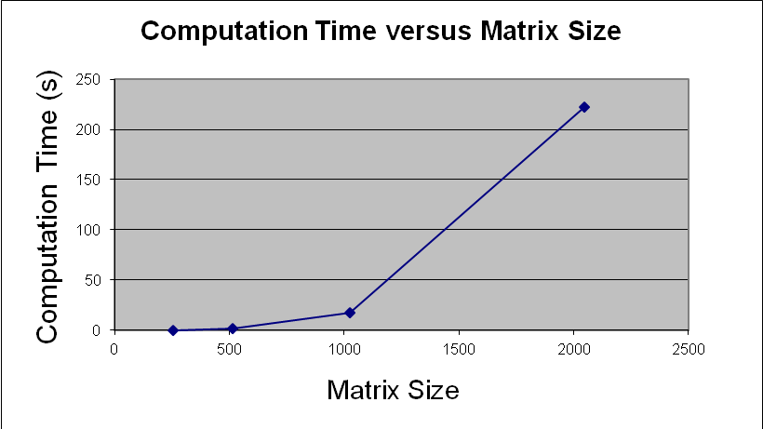
Matrix Size Scalability

Slide 3
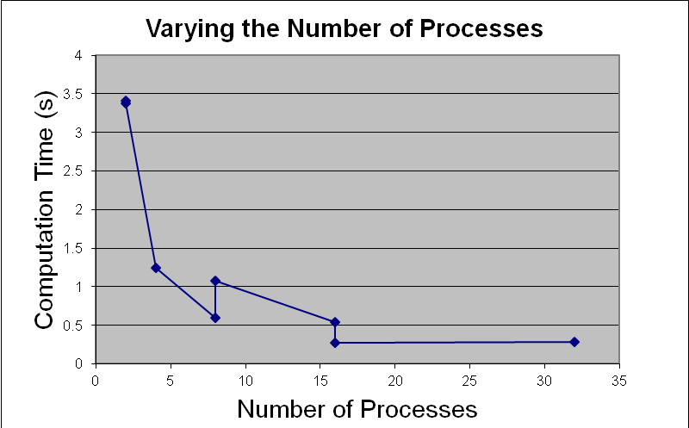
Process Scalability

Slide 4
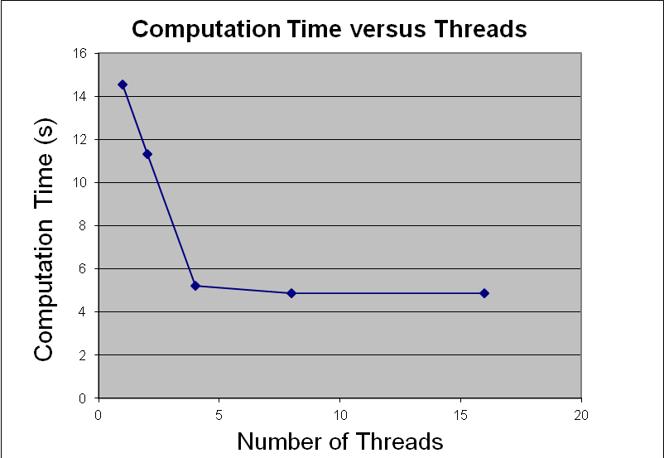
Thread Scalability

Slide 5
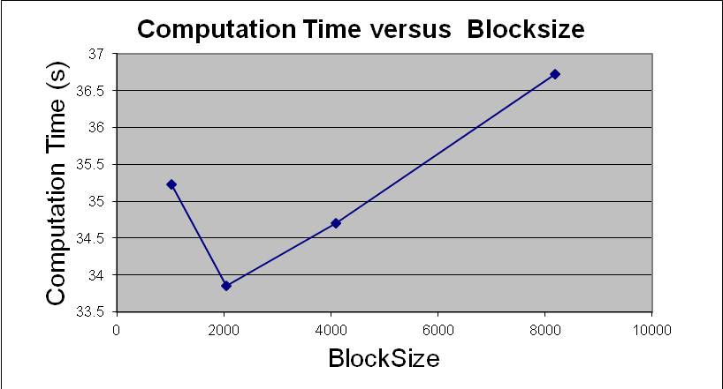
Blocksize Scalability

Slide 6
Conclusions
Slightly worse performance than Lab5 and Lab3 on the smallest cases
Scalability is much better
  Process improvements
  Blocksize improvements
  Thread improvements
  Best Run: N = 4096 – 7.36 minutes

